Slide 1
World Religions
&
Christian Denominations

Slide 2
Old Tolerance
  (1) there is objective truth that can be known;
  (2) various people, groups, and perspectives each think they know what that objective truth is; and
  (3) as people/groups disagree, dialogue, and debate their conflicting views of the truth, everyone involved will have an opportunity to learn, grow, change, and possibly arrive together at the truth.
Notes:
DA Carson The Intolerance of Tolerance
https://theresurgence.com/2013/11/14/intolerant-tolerance

Slide 3
New Tolerance
there is no objective truth that can be known;
various people, groups, and perspectives do not have the truth but only what they believe to be the truth; and
various people, groups, and perspectives should not argue and debate their disagreements because there is no truth to be discovered and to assume otherwise only leads to needless conflicts and prejudices.
Notes:
DA Carson The Intolerance of Tolerance
https://theresurgence.com/2013/11/14/intolerant-tolerance

Slide 4


Slide 5
Truth as Wine Tasting
Tasting Wine vs Banking
In wine tasting, everyone has their favourite blends and no one is necessarily right or wrong—it all depends on individual palates. No one has the right to declare as an absolute truth that simply because they prefer a specific grape or vintage, it is superior to all other wines.
The problem is, the God of the Bible sees truth like banking, not wine tasting.
Notes:
Today truth is more like wine tasting than banking. In banking, there is a right and wrong answer. If you deposit a thousand dollars in a new bank account and a week later try to withdraw eighty dollars, you would not be willing to agree to disagree when the teller says your account is empty.
But many people don’t see truth like banking anymore. Instead, they see it more like wine tasting. In wine tasting, everyone has their favourite blends and no one is necessarily right or wrong—it all depends on individual palates. No one has the right to declare as an absolute truth that simply because they prefer a specific grape or vintage, it is superior to all other wines.
The problem is, the God of the Bible sees truth like banking, not wine tasting.

Slide 6
“There is an appearance of humility in the protestation that the truth is much greater than any one of us can grasp, but if this is used to invalidate all claims to discern the truth it is in fact an arrogant claim to a kind of knowledge which is superior to [others]…”
–Lesslie Newbigin

Slide 7
Overview:
Pluralism-Relativism-Postmodernism
  All religions lead to God
  Beliefs don’t matter, only sincerity
  All religions pretty much the same

Slide 8

Notes:
Pluralists contend that no one religion can know the fullness of spiritual truth, therefore all religions are valid.
A common analogy is often cited to get the point across which I am sure you have heard — several blind men trying to describe an elephant. One feels the tail and reports that an elephant is thin like a snake. Another feels a leg and claims it is thick like a tree. Another touches its side and reports the elephant is a wall. This is supposed to represent how the various religions only understand part of God, while no one can truly see the whole picture. To claim full knowledge of God, pluralists contend, is arrogance. When I occasionally describe this parable, and I can almost see the people nodding their heads in agreement.
the only way this parable makes any sense, however, is if the person telling the story has seen the whole elephant. Therefore, the minute one says, 'All religions only see part of the truth,' you are claiming the very knowledge you say no one else has. And they are demonstrating the same spiritual arrogance they so often accuse Christians of.
In other words, to say all is relative, is itself a truth statement but dangerous because it uses smoke and mirrors to make itself sound more tolerant than the rest. Most folks who hold this view think they are more enlightened than those who hold to absolutes when in fact they are really just as strong in their belief system as everyone else. I do not think most of these folks are purposefully using trickery or bad motives. This is because they seem to have even convinced themselves of the "truth" of their position, even though they claim "truth" does not exist or at least can't be known. Ironic isn't it? The position is intellectually inconsistent.
http://www.monergism.com/thethreshold/articles/onsite/keller.html

Slide 9
“The soul of religion is one, but it is encased in a multitude of forms.” The Hindu mystic Ramakrishna used to speak of himself as the same soul that had been born previously as Rama, Krishna, Buddha and Jesus.”
-Mahatma Gandhi

Slide 10
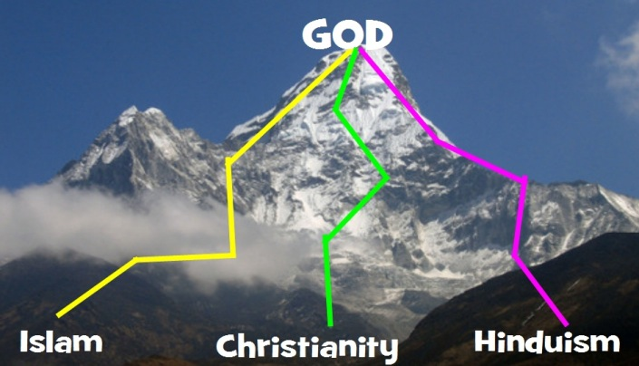
Do all paths lead to God?
All religions are basically the same
No one knows the truth about God.
No one can know the ultimate truth about God in a way that invalidates other peoples' religious opinions
It's arrogant to say that you have the truth religiously
It is arrogant to try to persuade other people to believe what you believe religiously.
Notes:
The flaw with this “religion” is that those are all dogmatic statements of belief. Religious relativism essentially destroys its own argument with its argument.
It's just as arrogant to claim relativism, as it is to claim religious truth.
Challenge to Relativist: At least look at it, doubt it, the way you doubt religion. Look at your own beliefs with the same critical apparatus you use to look at other people's beliefs. See that it's a religious dogma like others and see if it holds water as a religious dogma. Is it true? Is relativism true? Ask yourself this important question.

Slide 11
Doesn’t matter what you believe as long as you are sincere
Weaknesses of this viewpoint:
  Personal experience
  Romans 10:1-3
  Nazis/ISIS
Why do people like this argument?
  Non-confrontational
  Ignorance
Notes:
“Brothers and sisters, my heart’s desire and prayer to God for the Israelites is that they may be saved. For I can testify about them that they are zealous for God, but their zeal is not based on knowledge. Since they did not know the righteousness of God and sought to establish their own, they did not submit to God’s righteousness.”

Slide 12
Don’t all religions believe the same thing?
Some worshippers within the different faiths deny this fiercely.
      “Fight and slay the pagans wherever you find them.” (Qur”an, sura 9.5)
Even a basic understanding finds huge differences.
It is the academics sitting in their studies who write books saying that all religions are the same: the practitioners on the ground think differently.

Slide 13
all define god differently
Occult religions: animism, witchcraft, magic and some elements of the New Age.
Imperial religions: the divine kings in Egypt and Mesopotamia, the Caesars of the Roman empire, the Shinto emperors of Japan, Hitler, Mao and Stalin.
Ascetic religions: Jainism, Buddhism, some strands in Hinduism
Fertility cults: Canaanites, through the lascivious statues in many Hindu temples, through places like London’s Soho and Amsterdam, to today’s XXX films and videos and the astronomical sales of pornography.
Social elite religions: Christian Science, Spiritualism, Scientology, Theosophy and many of the self-improvement cults.
Prophetic/Revelatory Religions: Isalm, Christianity, Judaism
Notes:
occult religions: These are concerned with spirits, often evil spirits, that need to be placated or manipulated. They may dwell in trees, sacred sites or people. They may belong to the ancestors or to nature. These spirits are as varied as the African witch doctor, the Mongolian shaman and the local sorcerer who seek to manipulate them. Occult religions are about spirits, not about God, let alone intimacy with Him.
imperial religions. They are not about God either. They are about the highest political authority, which demands total allegiance
ascetic religions: They are not about God either, but about self-renunciation. The self is renounced and mortified in order to diminish its grip and to rid the person of being tied to this world. Sometimes, as in Buddhism, it is supposed to lead, after many lives, to the final elimination of the self, which is absorbed into the impersonal One or Monad. It has nothing whatever to do with intimacy with God. Indeed, in most branches of these ascetic religions there is no God to know intimatly!
fertility cults. They worship sex.
Social Elite religions: feed the religious instincts of the leisured classes and cost their adherents nothing apart from massive financial contributions. They are all about man and man’s cravings/greed, not God and intimacy with Him.
prophetic religions, even Islam, despite its high view of God, does not offer the worshiper intimacy with God: “Allah reveals his message. He never reveals himself.” The worshiper prays to him but cannot be said in any way to know Allah or have intimacy with him. Such a claim is deemed blasphemous. You can be killed for making it.
revelatory religions. There have only been two (closely connected) religions in world history that teach that God can be personally known by the believer. Only Judaism and its “child” Christianity maintain that God has given a reliable and personal disclosure of Himself to humankind. Judaism tells of God’s revelation of Himself through His mighty deeds of deliverance for Israel and through the words of the prophets. The Jewish people believed that God’s only residence on earth was the space between the wings of the cherubim figures above the “mercy seat” of the ark: this was located first in the moveable tabernacle and then in the temple at Jerusalem. Of course, Judaism is very differently placed today. There is no ark, no priesthood, no sacrifices, no tabernacle, no temple. Modern Judaism tends to focus on religious law, morality and synagogue worship.

Slide 14
What is god like?
Hinduism: impersonal, though approached through countless deities and statues.
Islam: Allah is personal, with no subordinate deities and an absolute prohibition of idols or any other way of representing God.
Buddhism is in many ways religion without god, and without even a final existence.
Christianity teaches that God has come to us and revealed in Jesus Christ

Slide 15
The Goal
Buddhism is nirvana, extinction or “the complete cessation of both desire and personality” – attained by the Buddha after no less than 547 births.
In Hinduism your atman (spirit), is reincarnated in another body and you start paying for the bad things you have done in a previous existence. Karma has the last word in both Buddhism & Hinduism, unless you are fortunate enough, after many lives, to find that the good you have done outweighs the bad, in which case there is hope of nirvana, where all consciousness ends and you return to the fundamental One or Monad that underlies and embraces everything in the universe.
Muslims look forward to a macho-man focused sensual paradise with wine, virgins and song.
The goal of all existence in Christianity is to know God and enjoy Him forever in the company of His redeemed people.

Slide 16
salvation
Christian assertion that none of us can save ourselves and make ourselves acceptable to God, its only by God’s grace that we can gain salvation.
The Buddhist version of the parable of the Prodigal Son: The wayward boy comes home and is met by the father, and then has to work off the penalty for his past misdeeds by years of servitude to his father.
Islam: The books kept by the recording angels will be opened, and Allah will weigh each person’s deeds in the scales (Qur’an, sura 23.102f.)
  “Feeling safe from the wrath of Allah” is one of the seventeen major sins in Islam
  one of the most common Muslim phrases is the fatalistic Insh’allah, “if it is Allah’s will”
Notes:
However faithful a Muslim you are, you cannot be confident of paradise.There is a strong doctrine of kismat (fate) running through Islamic teaching.
Even the promise that “the blessed shall dwell in paradise” is balanced by the further words “unless Allah ordains otherwise” (Qur’an, sura 11.108).

Slide 17

Mountain or Maze
Notes:
Many who urge that all religions do lead to God offer us the image of a mountain, with a number of routes going up to the top. It does not matter which route you take: any of them will get you to the top. We have seen that this view is untenable.
What if the real situation is like people trying to find their way through a maze? There are lots of routes that bring us to a dead end and fail to get us out of the maze. There is just one way through.

Slide 18
Key points
Relativism & Pluralism: All religions are equally right? That’s impossible. You can’t responsibly listen to all the religions and arrive at that conclusion.
Unparalleled claims of Jesus:
    John 8:58 “…before Abraham was born, I am!”
    Luke 10:18 “I saw Satan fall like lightning from heaven.”
    John 10:30 “I and the Father are one.”
    John 14:6 “I am the way and the truth and the life. No one comes to the Father except through me.”
    John 14:9-11 “Anyone who has seen me has seen the Father. How can you say, ‘Show us the Father’? 10 Don’t you believe that I am in the Father, and that the Father is in me? The words I say to you I do not speak on my own authority. Rather, it is the Father, living in me, who is doing his work. 11 Believe me when I say that I am in the Father and the Father is in me; or at least believe on the evidence of the works themselves.”
Notes:
All other religions: Prophets, let me show you the way to God.
Jesus is the only One that said, I am God and I’ve come to find you.
Either Jesus is a better way or He is an inferior way.

Slide 19
Unparalleled life of Jesus: John 8:46
  Islam: claims all the prophets were sinless…yet even their own scriptures contradict this. Abraham (26,82 & Moses 28, 16). Attempt to cover it by translating the word as “fault” instead of sin. Mohammed himself was told to ask for forgiveness for sin (47, 19)
  Hinduism: Krishna’s exploits with the milkmaids in the Bhagavad-Gita is evidence of sin.
  Buddha: The very fact that he endured rebirths implies a series of imperfect lives or unbalanced life. He left home in search of an answer, he didn’t start with the answer.
Notes:
Jn 8:46 “Can any of you prove me guilty of sin?”

Slide 20
Christian
denominations

Slide 21
“in necessary things unity; in uncertain things freedom; in everything compassion”
“In necessariis unitas, in dubiis libertas, in omnibus caritas.”
Notes:
The maxim is widely quoted in defence of theological and religious freedom, even though it raises the essential question of which things are necessary and which are doubtful or unnecessary.

Slide 22
Nicene-Constantinopolitan Creed
We believe in one God, the Father Almighty, Maker of heaven and earth, and of all things visible and invisible. And in one Lord Jesus Christ, the Son of God, the only-begotten, begotten of the Father before all ages. Light of Light; true God of true God; begotten, not made; of one essence with the Father, by whom all things were made; who for us men and for our salvation came down from heaven, and was incarnate of the Holy Spirit and the Virgin Mary, and became man. And He was crucified for us under Pontius Pilate, and suffered, and was buried. And the third day He rose again, according to the Scriptures; and ascended into heaven, and sits at the right hand of the Father; and He shall come again with glory to judge the living and the dead; whose Kingdom shall have no end.
And [we believe] in the Holy Spirit, the Lord, the Giver of Life, who proceeds from the Father; who with the Father and the Son together is worshipped and glorified; who spoke by the prophets. In one Holy, Catholic, and Apostolic Church. I acknowledge one baptism for the remission of sins. I look for the resurrection of the dead, and the life of the world to come. Amen.

Slide 23
Conviction
1 Tim 1: 3-7 “As I urged you when I was going to Macedonia, remain at Ephesus so that you may charge certain persons not to teach any different doctrine, 4 nor to devote themselves to myths and endless genealogies, which promote speculations rather than the stewardship from God that is by faith. 5 The aim of our charge is love that issues from a pure heart and a good conscience and a sincere faith. 6 Certain persons, by swerving from these, have wandered away into vain discussion, 7 desiring to be teachers of the law, without understanding either what they are saying or the things about which they make confident assertions.”

Slide 24
Pentecostal-Charismatic Movement
“In earlier generations, the Pentecostal-Charismatic Movement would have been labeled heresy. Instead, it is now the most dominant, aggressive, and visible strain of so-called Christianity in the world. It claims to represent the purest and most powerful form of the gospel. Yet it primarily proclaims a gospel of health and wealth, a message completely incompatible with the good news of Scripture. It threatens all who oppose its doctrine with charges of grieving, quenching, resisting, and even blaspheming the Holy Spirit. Yet no movement drags His name through the mud with greater frequency or audacity.”
-John MacArthur, Strange Fire
Notes:
As the largest religious television network on the planet, TBN beams its product 24/7 to more than one hundred countries on seventy satellites through more than eighteen thousand TV channels and cable affiliates.
Virtually all the network’s main celebrities advocate prosperity theology—telling listeners that God will give them healing, wealth, and other material blessings in return for their money. And TBN is not the only culprit. The network’s major competitors (like Daystar and LeSEA) provide similar platforms for Word of Faith teachers.
AOG 1937, 2007 changed name to ACC 1000 churches, 375000 members in Australia

Slide 25
Typical Teachings
Prosperity Gospel: Healthy & Wealthy
Miraculous Gifts of the Spirit: Speaking in Tongues
Spirit Baptism
Notes:
Perhaps the most controversial element of the Pentecostal outlook is the so-called “prosperity gospel,” meaning the belief that God will reward those with sufficient faith with both material prosperity and physical health. Some analysts distinguish between “neo-Pentecostal,” which they see as focused on the prosperity gospel, and classic Pentecostalism, oriented toward the gifts of the Spirit such as healings and tongues. Yet the Pew Forum data suggests that the prosperity gospel is actually a defining feature of all Pentecostalism; majorities of Pentecostals exceeding 90 percent in most countries hold to these beliefs.

Slide 26
Systemic errors
Elevate experience over truth
Elevate this life over the next

Slide 27
Over 90 percent of Pentecostals and Charismatics in Nigeria, South Africa, India, and the Philippines believe that “God will grant material prosperity to all believers who have enough faith.” And in every country, significantly more Pentecostals than other Christians believe this. . . . With such a great message, it’s no wonder people are flocking to sign up. The prosperity gospel is a divinely guaranteed version of the American dream: a house, a job, and money in the bank. And the global success of the prosperity gospel is the exporting of the American dream.
–Paul Alexander, Signs & Wonders, pages 63-64
Notes:
Book of Job is twisted—received everything back and more
John 10:10 Life to the FULL

Slide 28
Before going to college, I took a year off and joined Benny’s ministry as a “catcher” (someone who catches the people who are “slain in the spirit”) and personal assistant. This was a rite of passage in my family, as nearly every nephew worked for him at some point. It was a show of loyalty and gratitude. That year was a whirlwind tour of luxury: $25,000-a-night royal suites in Dubai, seaside resorts in Greece, tours of the Swiss Alps, villas on Lake Como in Italy, basking on the golden coast of Australia, shopping sprees at Harrods in London, and numerous trips to Israel, Hawaii, and everywhere in between. The pay was great, we flew on our own private Gulfstream, and I got to buy custom suits. All I had to do was catch people and look spiritual!
Costi Hinn
Notes:
Benny Hinn Is My Uncle, but Prosperity Preaching Isn’t for Me, Christianity Today September 2018
New book coming out July 2019

Slide 29
Prosperity Gospel
1 John 2:15-17 “Do not love the world or anything in the world. If anyone loves the world, love for the Father is not in them. 16 For everything in the world—the lust of the flesh, the lust of the eyes, and the pride of life—comes not from the Father but from the world. 17 The world and its desires pass away, but whoever does the will of God lives forever.”
Matthew 6:19 “Do not lay up for yourselves treasures on earth, where moth and rust destroy and where thieves break in and steal, but lay up for yourselves treasures in heaven, where neither moth nor rust destroys and where thieves do not break in and steal”
Notes:
Jude 17-19 “remember what the apostles of our Lord Jesus Christ foretold. 18 They said to you, “In the last times there will be scoffers who will follow their own ungodly desires.” 19 These are the people who divide you, who follow mere natural instincts and do not have the Spirit.”
History itself should decry this doctrine. Jesus—had nothing. Apostles?

Slide 30
The poverty of the prosperity gospel
“But godliness with contentment is great gain, 7 for we brought nothing into the world, and we cannot take anything out of the world. 8 But if we have food and clothing, with these we will be content. 9 But those who desire to be rich fall into temptation, into a snare, into many senseless and harmful desires that plunge people into ruin and destruction. 10 For the love of money is a root of all kinds of evils. It is through this craving that some have wandered away from the faith and pierced themselves with many pangs.”
      1 Timothy 6:6-10
Notes:
Psalm 73:9 “Their mouths lay claim to heaven,
and their tongues take possession of the earth.”

Slide 31
prophecy
John 14:17, 26 “…the Spirit of truth…the Advocate, the Holy Spirit, whom the Father will send in my name, will teach you all things and will remind you of everything I have said to you.”
Heb 1:1-2; Ephesians 2:19-20
Fallible Prophecy?
  Biblical prophets were held to a standard of 100 percent accuracy. (Deut 13:1-5, 2 Peter 2, Jude, Mt 24:11, 24)
Notes:
“revelation from the Lord”
“the Lord spoke to me”
In the past God spoke to our ancestors through the prophets at many times and in various ways, 2 but in these last days he has spoken to us by his Son
“Consequently, you are no longer foreigners and strangers, but fellow citizens with God’s people and also members of his household, 20 built on the foundation of the apostles and prophets, with Christ Jesus himself as the chief cornerstone.”
prophecy was never merely about fortune/future tellings. A vast majority of “prophecy” in the Bible is more of covenant enforcement.
Martin Luther put it this way: “Whenever you hear anyone boast that he has something by inspiration of the Holy Spirit and it has no basis in God’s Word, no matter what it may be, tell him that this is the work of the devil.”

Slide 32
multiple baptisms vs. Ephesians 4:4-6
WE BELIEVE...and practice two ordinances—(1) Water Baptism by Immersion after repenting of one's sins and receiving Christ's gift of salvation, and (2) Holy Communion (the Lord's Supper) as a symbolic remembrance of Christ's suffering and death for our salvation.
WE BELIEVE...the Baptism in the Holy Spirit is a Special Experience Following Salvation that empowers believers for witnessing and effective service, just as it did in New Testament times. [1 of 4 cardinal doctrines of the AG]
http://ag.org/top/Beliefs/Statement_of_fundamental_truths/sft_short.cfm
Notes:
“There is one body and one Spirit, just as you were called to one hope when you were called; 5 one Lord, one faith, one baptism; 6 one God and Father of all, who is over all and through all and in all.”
Gentile convert to Judaism baptism
JtB baptism (Luke 3)
Jesus’ disciples baptising pre crucifixion/ascension (John 4)
Metaphorical baptism be baptised with the baptism referring to the martyrdom (Mark 10)
Baptism of Spirit as promised to the APOSTLES in Acts 1 and fulfilled in Acts 2
Water Baptism for salvation offered to all after preaching in Acts 2

Slide 33
purpose of the miraculous gifts
Mark 16:15-20 “…the Lord worked with them and confirmed his word by the signs that accompanied it.”
Hebrews 2:1-4 “We must pay the most careful attention, therefore, to what we have heard, so that we do not drift away. 2 For since the message spoken through angels was binding, and every violation and disobedience received its just punishment, 3 how shall we escape if we ignore so great a salvation? This salvation, which was first announced by the Lord, was confirmed to us by those who heard him. 4 God also testified to it by signs, wonders and various miracles, and by gifts of the Holy Spirit distributed according to his will.”

Slide 34
Romans vs. Corinthians
Romans 12:6-8 vs. 1 Corinthians 12:7-11
Romans 1:11-13 vs. 1 Corinthians 1:12-16
Acts 8:9-24
Acts 10-11
Notes:
Acts 8-note that Philip was one of the 7 in Acts 6:6 that the Apostles had laid their hands on.
2 Timothy 1:6
Acts 10-11 Gifts of the HS were more for Peter & the other Apostles who were still resistant to the Gentiles being saved. Key verse is Acts 11:15

Slide 35
tongues in the NT
Mark 16:17-18 mentions tongues as an apostolic sign along with:
  the ability to drive out demons
  pick up snakes with their hands and remain unharmed
  drink deadly poison without effect
  place their hands on sick people and heal
Acts 2, 10, 19 mentions tongues primarily as a part of the historical narrative and as actual intelligible languages
1 Cor 12-14: the only passage of Scripture that talks about the role of tongues in the Church. It is important to note that Paul wrote these chapters to rebuke the Corinthians for their MISUSE of the gift. Most of what he had to say restricted the use of tongues in the church.

Slide 36
1 Corinthians 12-13
1 Cor 12:31“But you are eagerly desiring the greater gifts.”
“Tongues of angels”: hypothetical examples that without LOVE are meaningless.
13:1-3 Paul affirms the importance of LOVE—miraculous languages without love are nothing. He was rebuking the Corinthians for using the gifts of the Spirit selfishly and without love. They were more interested in inflating their own egos or in enjoying a euphoric experience than they were in serving one another with the self-sacrificing concern that characterises agape love.
Notes:
What did Paul mean by the “tongues of angels?”
1.Some kind of angelic or heavenly language—something most Charismatic/ Pentecostals believe—a private prayer language, a heavenly language known only by God
2. OR was he simply making hypothetical cases—just as in the next verses:
a. Knowing all mysteries and knowledge (even Paul couldn’t make that claim!)
b. Giving all his possessions to the poor
c. Giving his body to be burned
Paul was speaking theoretically, suggesting that even if those things were true, without love they would be meaningless. (After all angels always speak in the Bible in a way that could be understood)

Slide 37
1 Corinthians 14
vv. 1-3 Paul was criticising the Corinthians for using their “gifts of tongues” to speak to God and not to men. Paul’s comment is not suggesting that tongues should be used as a prayer language; he was using irony, point out the futility of speaking in tongues without an interpreter, because only God would know if anything was said. Spiritual gifts were never intended to be used for God’s benefit, or for the benefit of the gifted individual. (1 Peter 4:10 )
vv. 4-19Paul was not commending the use of tongues for self-edification, but condemning people who were using the gift in violation of its purpose and in disregard of the principle of love (“Love is not self-seeking”).
Notes:
vv. 6-12 Paul’s point is that we must understand the importance of a clear meaning and comprehension otherwise no one will be built up and encouraged.
vv. 13-17 In other words, the tongues-speakers in Corinth were being selfish, ignoring the rest of the people in the congregation, muddying the message the gift was designed to communicate, and doing it all just to gratify their own egos, to show off, and to demonstrate their spirituality to one another.
Paul insisted that when tongues were spoken in the church, someone should interpret (14:13, 27). If Paul really had in mind a private prayer language that wouldn’t make much sense to command interpretation.
vv. 18-20 Paul’s heart: all about edifying—building up the Church vv. 21-23
A sign to unbelieving Jews: I Cor. 14:22 says, Tongues then, are a sign, not for believers but for unbelievers;... . The preceding context, which is a quote from Isa. 28:11,12 seems to strongly imply that this is a reference to a time when God pronounced judgment on the nation of Israel. When Israel mocked Isaiah for the seemingly simple repetitious message, God blasted them by informing them that God's speaking to them will be through stammerings and an unrecognizable tongue. In 701B.C. the Jews were awakened from their sleep by the babble of Assyrians. Again in 609 B.C. they heard the Babylonian dialect. These Gentiles speaking in the midst of, and in authority over, the Jews was evidence of God's judgment fulfilled: His hand of blessing was off of them, at least for the time being while they were being judged. The same is true of the evil generation of Christ's and the Apostles' day. Hearing foreign tongues being spoken at the temple mount was highlighted by Peter's use of Isaiah to point out God's judgment on unbelieving Israel. Note the phrase this people in v.21. The argument goes back to Pentecost where Jews first were confronted with the sign of tongues and again in Acts 10 and 19, the gift was given as a sign to Jews that gentiles are included in the New Covenant.
vv. 24-25
All prophesy. If one after another speak the word of spiritual exhortation. He is convinced of all, he is judged of all; literally, he is being convicted by all, he is being examined by all; in other words, each address is calculated to awaken conviction in him and to search his heart. Thus the address of St. Peter pierced the consciences of his bearers, when the tongues even of Pentecost produced no effect beyond that of irreverent wonder. (Acts 2)

Slide 38
1 Corinthians 14
vv. 21-23 A sign to unbelieving Jews: v. 22 is a quote from Isa. 28:11,12 and seems to strongly imply that this is a reference to a time when God pronounced judgment on the nation of Israel. ft was given as a sign to Jews that gentiles are included in the New Covenant.
v. 27 tongues must be interpreted
v. 33 For God is not a God of disorder but of peace—as in all the congregations of the Lord’s people.
Notes:
When Israel mocked Isaiah for the seemingly simple repetitious message, God blasted them by informing them that God's speaking to them will be through stammerings and an unrecognizable tongue. In 701B.C. the Jews were awakened from their sleep by the babble of Assyrians. Again in 609 B.C. they heard the Babylonian dialect. These Gentiles speaking in the midst of, and in authority over, the Jews was evidence of God's judgment fulfilled: His hand of blessing was off of them, at least for the time being while they were being judged. The same is true of the evil generation of Christ's and the Apostles' day. Hearing foreign tongues being spoken at the temple mount was highlighted by Peter's use of Isaiah to point out God's judgment on unbelieving Israel. Note the phrase this people in v.21. The argument goes back to Pentecost where Jews first were confronted with the sign of tongues and again in Acts 10 and 19
by insisting any language spoken in tongues in the church must be translated by someone with the gift of interpretation (1 Cor. 12:10; 14:27), Paul indicated that the gift consisted of rational languages. The word for interpretation is hermeneuo (from which we get hermeneutics), which refers to a “translation” or an “accurate unfolding of the meaning.” Obviously, it would be impossible to translate nonsensical gibberish, since translation requires concrete meanings in one language to be rendered correctly into another.

Slide 39
JOHN CHRYSOSTOM
(344-407)
[Commenting on 1 Corinthians 12:] This whole place is very obscure: but the obscurity is produced by our ignorance of the facts referred to and by their cessation, being such as then used to occur but now no longer take place.

Slide 40
Augustine
(354-430)
In the earliest times, the Holy Spirit fell upon them that believe and they spoke with tongues, which they had not learned, as the Spirit gave them utterance. These were signs adapted to the time. For there was this betokening of the Holy Spirit in all tongues to show that the gospel of God was to run through all tongues over the whole earth. That thing was done for a sign, and it passed away.

Slide 41
THEODORET OF CYRUS
(393-466)
In former times those who accepted the divine preaching and who were baptised for their salvation were given visible signs of the grace of the Holy Spirit at work in them. Some spoke in tongues which they did not know and which nobody had taught them, while others performed miracles or prophesied. The Corinthians also did these things, but they did not use the gifts as they should have done. They were more interested in showing off than in using them for the edification of the church. . . . Even in our time grace is given to those who are deemed worthy of holy baptism, but it may not take the same form as it did in those days.

Slide 42
MARTIN LUTHER
(1483-1546)
In the early Church the Holy Spirit was sent forth in visible form. He descended upon Christ in the form of a dove (Matt. 3:16), and in the likeness of fire upon the apostles and other believers. (Acts 2:3.) This visible outpouring of the Holy Spirit was necessary to the establishment of the early Church, as were also the miracles that accompanied the gift of the Holy Ghost. Paul explained the purpose of these miraculous gifts of the Spirit in 1 Corinthians 14:22, Tongues are for a sign, not to them that believe, but to them that believe not. Once the Church had been established and properly advertised by these miracles, the visible appearance of the Holy Ghost ceased.

Slide 43
JOHN CALVIN
(1509-1564)
Though Christ does not say exactly whether He wished [miracle-working] to be an occasional gift, or one to abide in His Church for ever, yet it is more likely that miracles were only promised for the time, to add light to the new and as yet unknown Gospel. . . . We certainly see that their use ceased not long after [the apostolic age], or at least, instances of them were so rare that we may gather they were not equally common to all ages. It was the result of absurd greed and self-seeking among those who followed on [in later church history], that they made up empty fabrications in order that they should not altogether lack miracles. This threw the door wide open to Satan’s lies, not only with delusions taking the place of faith, but with simple men being pulled off the right road by the pretext of signs.

Slide 44
JOHN Owen
(1616-1683)
Gifts which in their own nature exceed the whole power of all our faculties, that dispensation of the Spirit is long since ceased and where it is now pretended unto by any, it may justly be suspected as an enthusiastic delusion.

Slide 45
Matthew Henry
(1662-1714)
The gift of tongues was one new product of the Spirit of prophecy and given for a particular reason, that, the Jewish pale being taken down, all nations might be brought into the church. These and other gifts of prophecy, being a sign, have long since ceased and laid aside, and we have no encouragement to expect the revival of them; but, on the contrary, are directed to call the Scriptures the more sure word of prophecy, more sure than voices from heaven; and to them we are directed to take heed, to search them, and to hold them fast, 2 Peter 1:19.

Slide 46
JAMES BUCHANAN (1804-1870)
The miraculous gifts of the Spirit have long since been withdrawn. They were used for a temporary purpose. They were the scaffolding which God employed for the erection of a spiritual temple. When it was no longer needed the scaffolding was taken down, but the temple still stands, and is occupied by his indwelling Spirit; for, Know ye not that ye are the temple of God, and that the Spirit of God dwelleth in you? (1 Cor. iii. 16)

Slide 47
MARTYN LLOYD-JONES
(1899-1981)
Once these New Testament documents were written the office of a prophet was no longer necessary. Hence in the Pastoral Epistles which apply to a later stage in the history of the Church, when things had become more settled and fixed, there is no mention of the prophets. It is clear that even by then the office of the prophet was no longer necessary, and the call was for teachers and pastors and others to expound the Scriptures and to convey the knowledge of the truth.

Slide 48
The Sinners Prayer

Slide 49


Slide 50
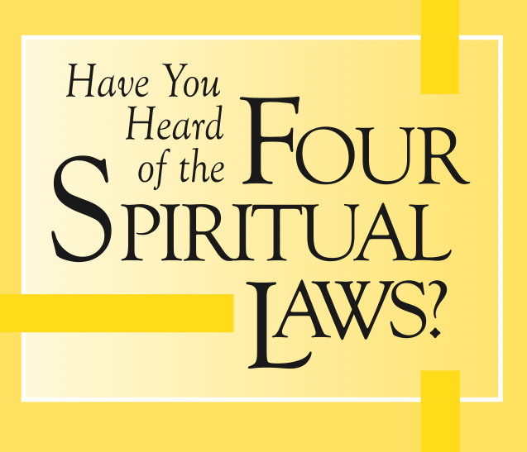
The sinners prayer
God loves you and offers a wonderful plan for your life
Man is sinful and separated from God.
Jesus Christ is God’s only provision for man’s sin.
We must individually receive Jesus Christ as Savior and Lord; then we can know and experience God’s love and plan for our lives.
Notes:
Campus Crusade for Christ CRU
Christian Union

Slide 51
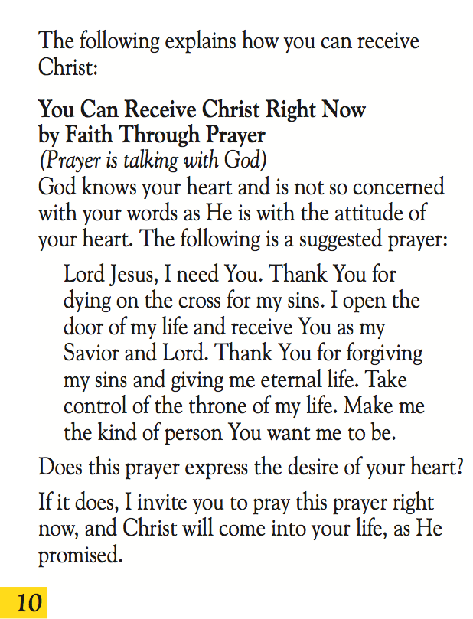
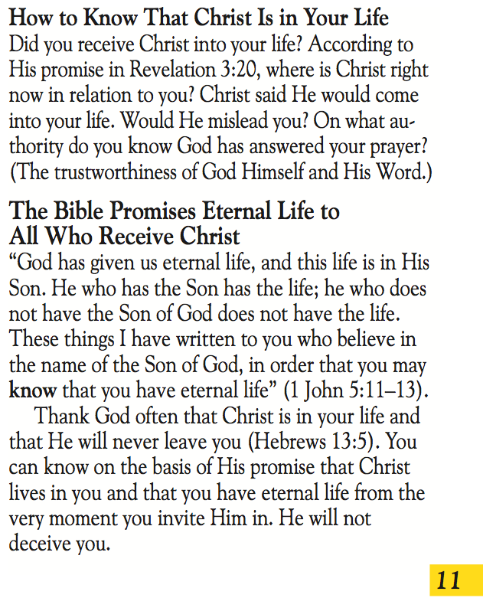

Slide 52
"Most of all, perhaps, we need intimate knowledge of the past. Not that the past has any magic about it, but because we cannot study the future, and yet need something to set against the present, to remind us that the basic assumptions have been quite different in different periods and that much which seems certain to the uneducated is merely temporary fashion. A man who has lived in many places is not likely to be deceived by the local errors of his native village; the scholar has lived in many times and is therefore in some degree immune from the great cataract of nonsense that pours from the press and the microphone of his own age."
–CS Lewis, Learning in Wartime, 1939

Slide 53
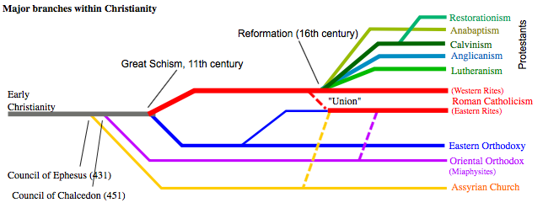
The Reformation (16th Century)
“Church” began to splinter
Majority still held to infant baptism, though they disagreed on its significance
Notes:
Although things weren't ideal after the Reformation, for the first time in over a thousand years the general populace was reading the Scriptures. By the early 1600s, one hundred years after the Reformation was initiated, there were various branches of European Christendom
The majority still held to the validity of infant baptism even though they disagreed on its significance. Preachers tended to minimize baptism because people hid their lack of commitment behind sayings like "I am a baptized Lutheran and that's that." The influence of the preachers eventually led to the popular notion that one was forgiven at infant baptism but not yet reborn. Most Protestants were confused or ambivalent about the connection between rebirth and forgiveness.

Slide 54
The Great Awakening (17th Century)
Great Awakening preachers created an environment that made man aware of his need for an adult confession experience.
Jonathan Edwards, George Whitfield and John Wesley furthered ideas of radical repentance and revival.
The use of Revelation 3:14-20 to convert non-christians becomes popular, using the Mourner’s Seat
For the first time in church history baptism was merely an external matter--only an outward sign of an inward grace.

Slide 55
Charles Finney (1792-1875)
Mourner’s Seat—Anxious Seat
“The church has always felt it necessary to have something of this kind to answer this very purpose. In the days of the apostles, baptism answered this purpose. The gospel was preached to the people, and then all those who were willing to be on the side of Christ, were called out to be baptised. It held the place that the anxious seat does now as a public manifestation of their determination to be Christians”
Lectures on Revivals of Religion, By Charles Grandison Finney

Slide 56
Dwight Moody (1837-1899)
&
R.A. Torrey (1856-1928)
Anxious Seat—Inquiry Room
  Ask questions, show scriptures, and then pray.
  This was where a systematic Sinner's Prayer began, but was not called as such until the time of Billy Sunday.
Torrey modified Moody's approach to include "on the spot" street conversions.
  He popularised the idea of instant salvation
  Salvation outside of church or a life of Lordship became more common

Slide 57
Billy Sunday (19th Century)
Well-known baseball player from Iowa, converted in the Pacific Garden Mission. (Moody)
first to mix ideas of entertainment with ministry
By the early 1900s he had become a great well-known crusade leader
  fire and brimstone sermons followed by an offer of salvation
    a prayer, a walk down his "sawdust trail”, or a handshake
Crusades become acceptable to all denominations, which eventually led to a change in their theology.
  Large religious bodies sold out on their reservations toward these new conversion practices to reap the benefits of potential converts from the crusades because of the allure of success.

Slide 58
Billy Graham
Converted at a crusade in 1936
By the 1940s-50s he was leading crusades
Graham's crusade counsellors were using a prayer that had been sporadically used for some time. It began with a prayer from his Four Steps to Peace with God. The original four-step formula came during Billy Sunday's era called in a tract called Four Things God Wants you to Know.
The altar call system of Graham had been refined by a precise protocol of music, trained counsellors and a speaking technique all geared to help people 'accept Christ as Savior.'

Slide 59
Bill Bright
In the late 1950s he came up with the exact form of the currently popular Four Spiritual Laws so that the average believer could take the crusade experience into the living room of their neighbour.
It concluded with:
  "Lord Jesus, I need You. Thank You for dying on the cross for my sins. I open the door of my life and receive You as my Savior and Lord. Thank You for forgiving my sins and giving me eternal life. Take control of the throne of my life. Make me the kind of person You want me to be."
Notes:
Founder of CRU—Christian Union

Slide 60
Key Passages
Revelation 3:14-20
    3:14, 22 Written to lukewarm Christians
    Calling them to repentance
Romans 10:9-13
    1:7, 10:1 written to Roman christians, specifically about the Jews in this section
    OT Citation in Ro 10:13: Joel 2
    Same passage used in Acts 2 by Peter (a sermon concluded with a call to Repent & Be Baptized)
    Same phrase “call on the name of the Lord” used by Ananias in Acts 22:16 at Paul’s conversion, challenging Saul (Paul,) to be baptised, wash his sins away.
Notes:
Perhaps John 3:16 is worth noting as well. John 3:3-5 is within that context—ECF unanimously say that Jesus is talking about Baptism.

Slide 61


Slide 62
Faith alone
Ephesians 2:1-9
Romans 3:19-31
Faith
vs
Works
Notes:
Be careful to not over react.
Paul, in both passages, is emphasising Faith as opposed to Works of the Law
Saved by Grace through faith…our works? No meritous value in regards to salvation. we agree.
People arguing against baptism on the basis of faith alone are inconsistent. They still teach sinners prayer. They on some level expect repentance.

Slide 63
Catholicism
Church Tradition equal with scripture
Supremacy of the Pope
Mary
Salvation includes Muslims
Purgatory
Infant Baptism/Original Sin
Saints

Slide 64
Church Tradition = with scripture
80 Sacred Tradition and Sacred Scripture, then, are bound closely together and communicate one with the other.
82 As a result the Church, to whom the transmission and interpretation of Revelation is entrusted, "does not derive her certainty about all revealed truths from the holy Scriptures alone. Both Scripture and Tradition must be accepted and honoured with equal sentiments of devotion and reverence.
100 The task of interpreting the Word of God authentically has been entrusted solely to the Magisterium of the Church, that is, to the Pope and to the bishops in communion with him.
Mark 7:5-13
Ephesians 2:19-22
Hebrews 2:1-4

Slide 65
Anti-scripture?
"Since it is clear from experience that if the Sacred Books are permitted everywhere and without discrimination in the vernacular (in the common language of the people, D.R.) there will by reasons of the boldness of men arise therefrom more harm than good..." (Canons and Decrees of the Council of Trent, p. 274).
"As it has been clearly shown by experience that, if the holy Bible in the vernacular is generally permitted without any distinction, more harm than utility is thereby caused..." (Great Encyclical Letters of Leo XIII, pp. 412-413).
"In early times the Bible was read freely by the lay people...New dangers came in during the Middle Ages...To meet those evils, the Council of Toulouse (1229) and Terragona (1234) forbade the laity to read the vernacular translations of the Bible. Pius IV required bishops to refuse lay persons leave to read even Catholic versions of Scripture unless their confessors or parish priests judged that such reading was likely to prove beneficial." (Catholic Dictionary, p. 82).

Slide 66
Supremacy of the Pope
882 The Pope, Bishop of Rome and Peter's successor, "is the perpetual and visible source and foundation of the unity both of the bishops and of the whole company of the faithful." "For the Roman Pontiff, by reason of his office as Vicar of Christ, and as pastor of the entire Church has full, supreme and universal power over the whole Church, a power which he can always exercise unhindered."
891 The Roman Pontiff, head of the college of bishops, enjoys this infallibility in virtue of his office, when, as supreme pastor and teacher of all the faithful--who confirms his brethren in the faith--he proclaims by a definitive act a doctrine pertaining to faith or morals. ... The infallibility promised to the Church is also present in the body of bishops when, together with Peter's successor, they exercise the supreme Magisterium," above all in an Ecumenical Council. ... This infallibility extends as far as the deposit of divine Revelation itself.
The Catholic book, "My Catholic Faith" which is based on the Baltimore Catechism, on page 251, says, "The Pope can make and unmake laws for the entire Church; his authority is supreme and unquestioned. Every bishop, every priest, every member of the Church is subject to him."
Matthew 16:18-19 (Acts 2)
Matthew 20:20-28
Matthew 23:8-12
Luke 22:24-27
2 Thess 2:1-4
Notes:
Side note: Elders/Bishop: Titus 2:5-9 married men (1 Tim 4:3)
saints/priest: 1 Corinthians 1:2 & 1 Peter 2:5-10
Mt 23 moses’ seat cathedra

Slide 67
Mary
508 From among the descendants of Eve, God chose the Virgin Mary to be the mother of his Son. "Full of grace," Mary is "the most excellent fruit of redemption" (SC 103): from the first instant of her conception, she was totally preserved from the stain of original sin and she remained pure from all personal sin throughout her life.
966 "Finally the Immaculate Virgin, preserved free from all stain of original sin, when the course of her earthly life was finished, was taken up body and soul into heavenly glory, and exalted by the Lord as Queen over all things, so that she might be the more fully conformed to her Son ..." The Assumption of the Blessed Virgin is a singular participation in her Son's Resurrection . . . "In giving birth you kept your virginity . . . You conceived the living God and, by your prayers, will deliver our souls from death" (Byzantine Liturgy, Troparion, Feast of the Dormition, August 15th.).
969 "... Taken up to heaven she did not lay aside this saving office but by her manifold intercession continues to bring us gifts of eternal salvation. ... Therefore the Blessed Virgin is invoked in the Church under the titles of Advocate, Helper, Benefactress, and Mediatrix.”
971 "The Church's devotion to the Blessed Virgin is intrinsic to Christian worship." The Church rightly honours "the Blessed Virgin with special devotion. ..." The liturgical feasts dedicated to the Mother of God and Marian prayer, such as the rosary, an "epitome of the whole Gospel," express this devotion to the Virgin Mary.
Luke 11:27-28
Luke 22:24-26
1 Timothy 2:5
John 14:16, 26

Slide 68
Salvation includes Muslims
841 The plan of salvation also includes those who acknowledge the Creator, in the first place amongst whom are the Muslims; these profess to hold the faith of Abraham, and together with us they adore the one, merciful God, mankind's judge on the last day.
3. The Church regards with esteem also the Moslems. They adore the one God, living and subsisting in Himself; merciful and all-powerful, the Creator of heaven and earth,(5) who has spoken to men; they take pains to submit wholeheartedly to even His inscrutable decrees, just as Abraham, with whom the faith of Islam takes pleasure in linking itself, submitted to God. Though they do not acknowledge Jesus as God, they revere Him as a prophet. They also honour Mary, His virgin Mother; at times they even call on her with devotion. In addition, they await the day of judgment when God will render their deserts to all those who have been raised up from the dead. Finally, they value the moral life and worship God especially through prayer, almsgiving and fasting.
John 14:6
James 2:19
Ephesians 1:7
Notes:
#3
DECLARATION ON
THE RELATION OF THE CHURCH TO NON-CHRISTIAN RELIGIONS
NOSTRA AETATE
PROCLAIMED BY HIS HOLINESS
POPE PAUL VI
ON OCTOBER 28, 1965
http://www.vatican.va/archive/hist_councils/ii_vatican_council/documents/vat-ii_decl_19651028_nostra-aetate_en.html

Slide 69
Purgatory
1030 All who die in God's grace and friendship, but still imperfectly purified, are indeed assured of their eternal salvation, but after death they undergo purification, so as to achieve the holiness necessary to enter the joy of heaven.
1031 The Church gives the name Purgatory to this final purification of the elect, which is entirely different from the punishment of the damned. The Church formulated her doctrine of faith on Purgatory especially at the Council of Florence and Trent. The tradition of the Church, by reference to certain texts of Scripture, speaks of a cleansing fire. "As for certain lesser faults, we must believe that, before the Final Judgment, there is a purifying fire."
Matthew 25:31-46
Luke 16:19-31
Hebrews 9:23-28
Notes:
#3
DECLARATION ON
THE RELATION OF THE CHURCH TO NON-CHRISTIAN RELIGIONS
NOSTRA AETATE
PROCLAIMED BY HIS HOLINESS
POPE PAUL VI
ON OCTOBER 28, 1965
http://www.vatican.va/archive/hist_councils/ii_vatican_council/documents/vat-ii_decl_19651028_nostra-aetate_en.html

Slide 70
Infant Baptism
1250 Born with a fallen human nature and tainted by original sin, children also have need of the new birth in Baptism to be freed from the power of darkness and brought into the realm of the freedom of the children of God ... The Church and the parents would deny a child the priceless grace of becoming a child of God were they not to confer Baptism shortly after birth.
Matthew 28:18-20
Acts 2:38
Acts 16:29-34
Notes:
#3
DECLARATION ON
THE RELATION OF THE CHURCH TO NON-CHRISTIAN RELIGIONS
NOSTRA AETATE
PROCLAIMED BY HIS HOLINESS
POPE PAUL VI
ON OCTOBER 28, 1965
http://www.vatican.va/archive/hist_councils/ii_vatican_council/documents/vat-ii_decl_19651028_nostra-aetate_en.html

Slide 71
Original Sin
Psalm 51:5 "Behold, I was brought forth in iniquity, and in sin did my mother conceive me.” (ESV)
Romans 5:12-18
Ezekiel 18:4 “ Behold, all souls are mine; the soul of the father as well as the soul of the son is mine: the soul who sins shall die.”
Notes:
Psalm 51
Not a reference to original sin, but more so to David being conceived out of wedlock
This explains why David was not initially included in the meeting with Samuel as technically it could be argued David was not a true son of Jesse. However, God did include David as part of Jesse’s family much in the same way Jesus was considered a son of Joseph though conceived by the Holy Spirit.
No where in scripture is David’s mother mentioned by name. This is a bit unusual, as mothers of several ancient prophets and patriarchs are not only mentioned, but many times written about, as they often played a significant role in the upbringing of their children — such as Moses’ mother Jochebed (Exodus 6:20) and Samuel’s mother Hannah (1 Samuel 1:1-20).
However, David’s mother was different — as a wife who committed adultery, she brought shame upon Jesse and his family and it’s not surprising her name was excised from the Biblical account.
There are several possibilities on what happened here — Jesse’s wife had an affair with another man or Jesse had an affair with another woman (married or unmarried).
Perhaps David’s mother was a prostitute. It was not uncommon for children born from such an illicit relationship to live with the father.
Its not all that surprising that the pre-figure for Christ would be born under dubious conditions.
Romans 5
Two heads-goes against our individualism & our love of personal choice…we either follow Adam or Jesus
5:12 & 3:23 “all sinned”
What would've been the point of romans 1-3?
vv. 13-14 just because there was no law it didn’t mean everyone from Adam to Moses was exempt. 2:15 law written on consciences—therefore death still reigned 5:14
vv. 25-21 Paul begins to compare out the effects of the two men—Adam & Jesus…but the reality is they can’t even be compared:
v. 15 “the gift is not like the trespass”
v. 16 “Nor can the gift of God be compared with the result of one man’s sin…”
vv. 15 & 17 “how much more”
Paul’s point is that Jesus’ work isn’t merely a reversal of Adam’s…Death is purely negative—life consists of far more then an absence of death.
Why? Because of how Amazing this gift really is.

Slide 72
2 Timothy 2:22-26
“Flee the evil desires of youth and pursue righteousness, faith, love and peace, along with those who call on the Lord out of a pure heart. 23 Don’t have anything to do with foolish and stupid arguments, because you know they produce quarrels. 24 And the Lord’s servant must not be quarrelsome but must be kind to everyone, able to teach, not resentful. 25 Opponents must be gently instructed, in the hope that God will grant them repentance leading them to a knowledge of the truth, 26 and that they will come to their senses and escape from the trap of the devil, who has taken them captive to do his will.”

Slide 73
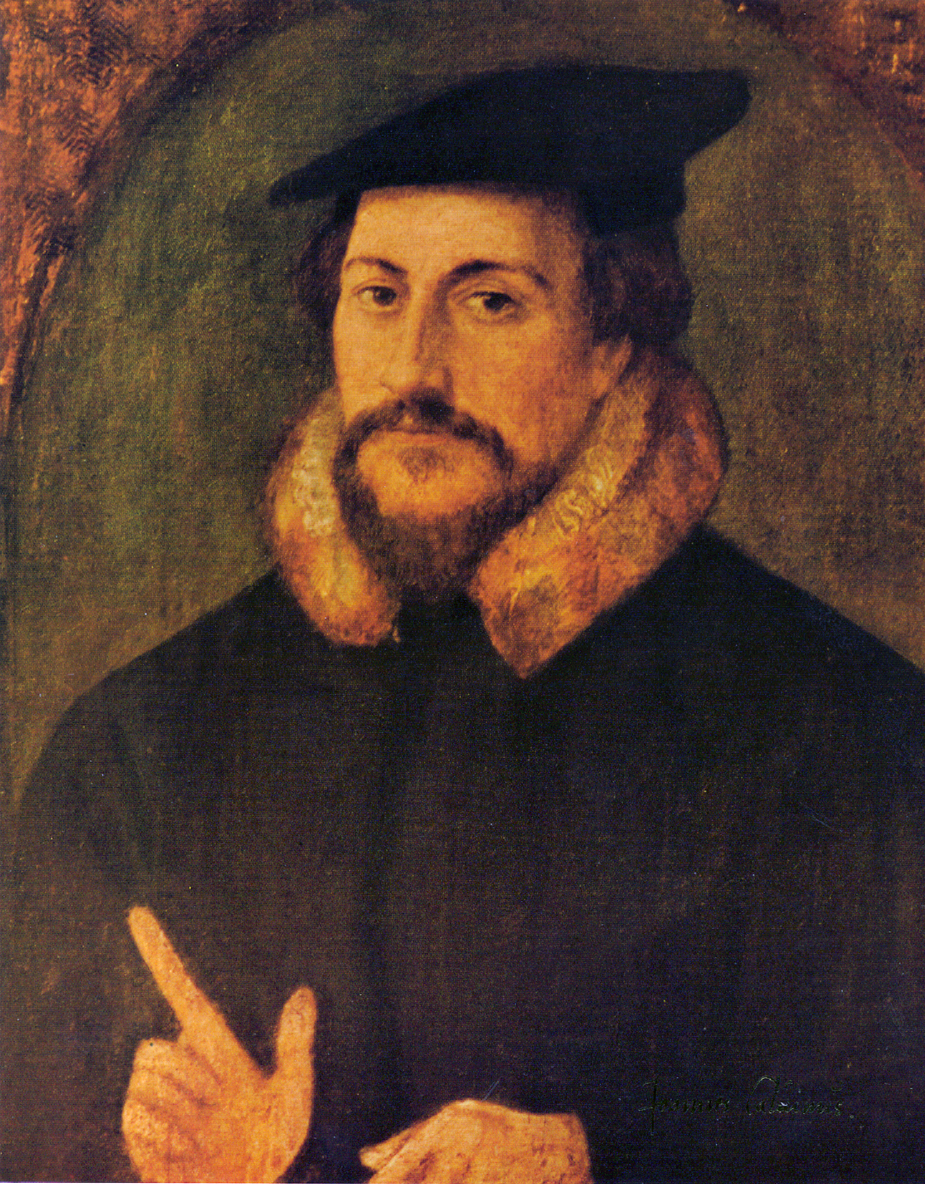
John Calvin (1508-1564)
Key part of the Protestant Reformation
Contemporary of Martin Luther
Follower of Augustine (354-430)
Denominations influenced by his teaching:
    Baptists, Presbyterians, Reformed, Anglicans, Church of Christ

Slide 74
calvinism
T: total depravity
U: unconditional election
L: limited atonement
I: irresistible grace
P: perseverance of the saints

Slide 75
Total Depravity
Strengths | Weaknesses
High view of how lost mankind is | Denies Free Will
Romans 3:12 | Cain (Genesis 4)
Ephesians 2:1 | Nathaniel (John 1:47)
Titus 3:3 | Centurion (Mt 8:10)
 | Cornelius (Acts 10:2, 35)
Notes:
There is absolutely no good in fallen man. Before he is converted, all his actions and thoughts are sinful and selfish. Therefore, there is absolutely nothing he can do to save himself: salvation is completely from God, and man plays no part in it. Only when God’s Spirit quickens a man and enables him to believe can he be saved.

Slide 76
unconditional election
Strengths | Weaknesses
God’s Sovereignty | Denies Free Will
Ephesians 2:8-9 | Salvation is a gift…not faith
Acts 13:48 | 13:46 implies free choice
Romans 8:29 | christians are predestined to become like Christ
 | 2 Thess 2:14 & Romans 10:13-17
Notes:
Unconditional Election, or Predestination, teaches that the decision about who will be saved is 100% God’s. He has decided in advance exactly who will be saved. Not only is there no way for us to save ourselves, but even if we wanted to be saved, unless God had already chosen us, we would have no chance of going to heaven.
Since God does nothing in vain, and since only the few “elect” will be saved, Christ must have died only for those who would be saved. Thus the doctrine of Limited Atonement flows logically from Unconditional Election, or Predestination.

Slide 77
limited atonement
Strengths | Weaknesses
High view of the cross and that God does nothing in vain | Limited sacrifice?
Matthew 26:28 | 1 Tim 2:4 & 1 Tim 4:10
Eph 5:25 | Romans 5:6
Acts 20:28 | Eph 5:25 and Acts 20:28: the idea that God bought the redeemed with his blood is certainly biblical, but that in no way necessitates that he only shed enough blood to redeem those who would be saved.
Notes:
Doctrine: Christ’s sacrifice on the cross was limited to those who would be saved. In other words, he did not bear the sins of all mankind, only those of the elect.
Since Christ died only for the elect, no grace is “wasted” on non-elect unbelievers. So when God’s grace, through his Spirit, starts to work in an unbeliever’s heart, it cannot be resisted.

Slide 78
Irresistible grace
Strengths | Weaknesses
Emphasises the Spirit’s Power | no free will
John 6:44 | John 12:32
Acts 16:14 | How was her heart opened? (16:13)
 | Acts 7:51, Galatians 5:4, Hebrews 10:29-30, Hebrews 12:15 and many other passages teach it is possible for people to resist God’s grace. How can grace be “irresistible” if so many people do in fact resist it?
Notes:
Doctrine: The Spirit of God draws men to Christ, and it is utterly impossible to resist God’s grace once this has begun to happen.
Since grace is irresistible, it follows that once you are saved, you are always saved. In other words, falling away is impossible.

Slide 79
Perseverance of the Saints
Once saved always saved
Strengths | Weaknesses
Security of Salvation | leads to lukewarm commitment
John 10:29 | Heb 6:4-12 & Heb 10:26-31
Romans 8:38-39 | John 15:6 & 1 Corinthians 10:1-13
1 John 2:19 | 2 Peter 2:20-22
 | Revelation 2 & 3
Notes:
Doctrine: Once a person is saved, it is impossible for that person to become “unsaved.” And if someone seems to be saved, but later leaves God, that is proof that he was never saved to begin with. Only the saints persevere to the end.
-Salvation is unconditional in the sense that there is nothing we can do to earn it, but it is not unconditional in the sense that we can lose it.

Slide 80
Jehovah Witnesses
Seventh Day Adventists
Mormonism

Slide 81
Jehovah’s Witnesses
www.jwfacts.com
The Watchtower
Jehovah
144000
Jesus

Slide 82
The Watchtower
“We all need help to understand the Bible, and we cannot find the Scriptural guidance we need outside the 'faithful and discreet slave' organization.”
    The Watchtower, Feb. 15, 1981.
Notes:
Obviously, the Watchtower Bible and Tract Society assumes a great deal, including being God's "visible theocratic organisation" and the 'faithful and discreet slave" teaching true Christian doctrine. The only problem is that the Watchtower brand of doctrine is not biblical doctrine. It is heavily filtered doctrine through Watchtower interpretations combined with selective questions and scripture quotes.
Of course, the Jehovah's Witnesses will strongly disagree with this statement. They say that they read and study their Bibles and only use the Watchtower literature as a guide to understanding God's word. But it is this very admission which condemns them because their doctrines are not found in the Bible. The proof is found, believe it or not, in the Watchtower's own writings. Consider this quote from The Watchtower magazine, August 15, 1981 that says:
"From time to time, there have arisen from among the ranks of Jehovah's people those, who, like the original Satan, have adopted an independent, faultfinding attitude...They say that it is sufficient to read the Bible exclusively, either alone or in small groups at home. But, strangely, through such 'Bible reading,' they have reverted right back to the apostate doctrines that commentaries by Christendom's clergy were teaching 100 years ago..."4
Did you get that? If you read the Bible by itself, you will become a Trinitarian because that is exactly what the Watchtower is referring to here when it says "apostate doctrines." In other words, if you read the Bible alone, you will not arrive at Watchtower doctrines. This is an amazing admission by the Watchtower organization. It is clear, Jehovah's Witnesses do not get their teachings from the Bible, but from the Watchtower literature.

Slide 83
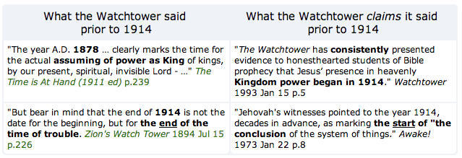


failed prophecy
Notes:
"Does God's rest day parallel the time man has been on earth since his creation? Apparently so. In what year, then, would the first 6,000 years of man's existence and also the first 6,000 years of Gods rest day come to an end? The year 1975. It means that within a relatively few years we will witness the fulfilment of the remaining prophecies that have to do with the "time of the end"." Awake! 1966 Oct 8 pp.19-20

Slide 84
Jehovah
"No striking or fundamental variation is shown either in the Old or the New Testament. There are no important omissions or additions of passages, and no variations which affect vital facts or doctrines.” -Reasoning from the Scriptures p. 64 | "Sometime during the second or third century C.E. the scribes removed the Tetragrammaton from both the Septuagint and the Christian Greek Scriptures and replaced it with Ky´ri·os, "Lord" or The·os´, “God.” -New World Translation of the Holy Scriptures - With References p.1564 1D The Divine Name in the Christian Greek Scriptures
Notes:
This undermines the integrity of the entire Bible, as if such a significant word has been changed, what else is wrong? On the other hand, if "Jehovah" did not appear in the New Testament, the meaning of key New World Translation Scriptures change.
There is no proof whatsoever to support this claim, as not a single ancient New Testament document has been found with YHWH in it. Several available manuscripts date back to this period. P47 dates prior to 300 A.D. and contains four uses of Kyrios from Revelation that the NWT translates as Jehovah. P66 dates from around 200 A.D. from John (written in 98 A.D) and contains five occurrences of Lord that appear in the NWT as Jehovah. Some manuscripts go back to within 25 years of John's writings, yet none contains YHWH.

Slide 85
Tetragrammaton
the four consonants which represent the name of God in the Old Testament.
rendered traditionally as “Jehovah” in the King James Version, but it is generally recognised that this represents a combination of the consonants of the tetragrammaton, יהוה (YHWH), and the vowels from a completely different Hebrew word, אֲדֹנָי (̒adonai, “master”), which were substituted by the Masoretes so that pronunciation of the Divine Name could be avoided.
Whenever יהוה (YHWH), appeared in the text, the presence of the vowels from the word אֲדֹנָי (̒adonai) signalled to the reader that the word אֲדֹנָי (̒adonai) was to be pronounced instead.

Slide 86
144000
Revelation 7:3-4
Revelation 14:1-5
Only from the tribes of Israel
Have the name of the Lamb & Father on their foreheads
Virgins
Never lied
Blameless
Notes:
One of the core doctrines of the Watchtower is that only 144,000 humans will go to heaven, where they are to rule as kings. Most Jehovah's Witnesses are not considered part of the 144,000 and do not expect to go to heaven. Rather they believe themselves part of the Great Crowd that will never die, but rather reside forever on earth.
“Little flock” Luke 12:32 problem is that Peter is in that crowd…and Judas.
Changed dates for the supposed “sealing” 1882, 1931, 1935 and then in 2007 this teaching was once again changed, with the admission that the Bible does not give a date for when the closing would occur.

Slide 87
Jesus
John 1:1
    "In the beginning was the word and the word was with God and the word was a god.”
Colossians 1:15
    "firstborn" means first created
Colossians 1:15-17
    "He is the image of the invisible God, the firstborn of all creation; because by means of him all [other] things were created in the heavens and upon the earth, the things visible and the things invisible, no matter whether they are thrones or lordships or governments or authorities. All [other] things have been created through him and for him. Also, he is before all [other] things and by means of him all [other] things were made to exist."
John 8:58
    " . . . Before Abraham came into existence, I have been."
Notes:
John 1:1
1-No “a” in the GK text
2-If Jesus is "a" god, according to the Witnesses, then doesn't that mean there are two gods? It would seem so; but the JW often answers by saying, "There is only one God but Jesus is like God. He is not the Almighty God. He is only the mighty god. And besides, there are those in the Bible who are called gods but really aren't." The biblical response is to go to Isaiah 10:21 where God himself is called the Mighty God. So if Jesus is not the Almighty God and only the mighty God, as the JW's maintain, then that makes Jesus God since GOD is called the mighty God the same as Jesus.
Col 1:15
1-There is a Greek word for "first created;" and it is not used here.
2-firstborn can certainly mean the first one born in a family. However, it can also mean preeminence, and it is a transferrable title. We see that Manasseh was called the firstborn, and Ehraim is the second born in Gen. 41:51-52; but in Jeremiah 31:9 Ephraim is called the firstborn." Therefore, "firstborn" is a title of preeminence that is transferrable and does not mean first created.
Col 1:15-17
1-The original Greek text does not contain the word “other.” There are two words for 'other' in Greek, heteros and allos; and neither is used here. The JW’s have added the English 'other' to make it fit their theology.
2-To the JW this means that Jesus created everything, but that is a problem because in Isaiah 44:24 it says that the LORD (Jehovah) created all things alone. "This is what the LORD says, your Redeemer, who formed you in the womb: I am the LORD, who has made all things, who alone stretched out the heavens, who spread out the earth by myself." Now, if Jesus created everything, then why does it say that the Lord (Jehovah in the Hebrew) did it by Himself? The only logical answer is that Jehovah is not simply the name of the Father, but that it is the name of God the Trinity. Therefore, since Jesus is God in flesh, it could be said that Jesus created all things and also that Jehovah did it alone.
John 8:58
They have translated the present tense “ego eimi,” “I am” from the Greek into the English perfect tense, "I have been." Though this can be done rarely in the New Testament, it is not correct here because Jesus was quoting the O.T. verse of Exodus 3:14 where God was telling Moses who He was: "God said to Moses, 'I AM WHO I AM. This is what you are to say to the Israelites: I AM has sent me to you.'" Jesus was purposely using the divine title: I AM.
Of course the Jehovah's Witness may not agree; so ask him if Jesus was saying that He "had been" before Abraham, then why does it say in the next verse that the Jews picked up stones to kill him? Why did they want to kill him for saying "I have been" when that was not an offense worthy of death? The truth is that they wanted to kill him for claiming to be God. You can verify this by turning to John 10:30-34 where you will see that is exactly why they wanted to kill him.
Additionally, about 250 years BC the Jews translated the Old Testament Hebrew Scriptures into Greek. It is called the Septuagint, also known as LXX. In the Septuagint, Exodus 3:14 is translated in the Greek in a present tense, i.e., I AM . . . Since Jesus was referring to Exodus 3:14, the correct translation is, therefore, "Before Abraham was, I AM."
Finally, you might want to tell the JW that even the Jews knew He was claiming to be God; but, the Jehovah's Witness (if he's quick enough) might say something like, "Jesus wasn't God; the Jews only thought that Jesus was claiming to be God." Then you can say, "Oh, I see. Then let me get this straight. You agree with the Pharisees--Jesus wasn't God? Is that correct?"

Slide 88
Seventh Day Adventist
Sabbath
Ellen G. White

Slide 89
Sabbath
The early Christians met on the first day of the week (Acts 20:7) most likely because of Christ’s resurrection on that day (Matthew 28:1, Revelation 1:10)
Synagogues were occasionally entered for the purpose of evangelism (Acts 17:2)
Why wasn’t Sabbath breaking included in at least one of the thirty lists of sins in the New Testament?
Colossians 2:16-23 & Romans 14:1-23
The first mention of Sunday being a day of rest was in 220AD by Origen. This is the beginning of the current false doctrine, that Sunday is the Christian Sabbath
Notes:
The edict of Constantine (321 A.D.) closing the courts
on Sunday and prohibiting some kinds of labor on that
day, is the first recognition of a seven-day week in
Roman law. The ancient Romans had a market day
every eight days, when the peasants came to town
to market, but it was in no sense a day of rest. In
the old Roman calendar there were many days when
the courts were closed and other public and private
business was not done. They had also many festivals
on which the people left their ordinary occupation
to take part in the celebrations, but these have no
periodicity like that of the week….

Slide 90
Ellen G. White
“17. The Gift of Prophecy: One of the gifts of the Holy Spirit is prophecy. This gift is an identifying mark of the remnant church and was manifested in the ministry of Ellen. G. White . As the Lord’s messenger, her writings are a continuing and authoritative source of truth which provide for the church comfort, guidance, instruction, and correction.”
Mrs. White says of her work: "This work is of God, or it is not, God does nothing in partnership with Satan. My work . . . bears the stamp of God or the stamp of the enemy. There is no halfway work in the matter. The testimonies are of the Spirit of God or of the Devil" Testimonies for the Church, Vol. 4, p. 230.

Slide 91
White was Wrong
Jerusalem's Future: White will be alive when Jesus returns
England will attack the United States (1862)
The Civil War is a sign Jesus is about to return
In 1850's Mrs. White said Jesus will return "in a few months"
Adventists living in 1856 will be alive when Jesus returns
Mrs. White saw Enoch on Jupiter or Saturn

Slide 92
Mormonism

Slide 93
History
Mormon Fundamentalism, Latter Day Saints
Began around 1820-1850s in the USA
13.5 Million followers
Sacred Texts: Bible, The Book of Mormon, Doctrine & Covenants, The Pearl of Great Price

Slide 94
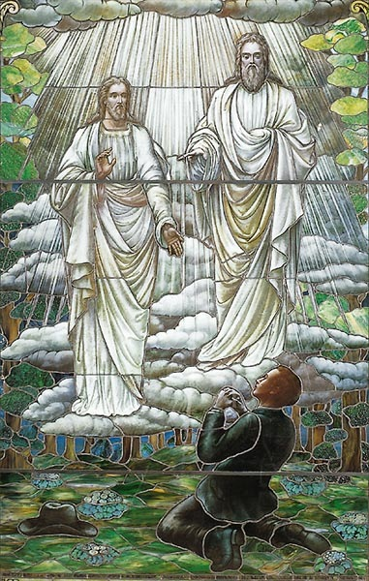
Joseph smith, Jr
Claimed to be directed by an angel to some buried Golden Plates (The Book of Mormon)
Claimed to have a series of visions beginning in the early 1820’s.
Claimed to be a Prophet and a Restorer of Christiatnity
In 1831 Smith and his followers moved west to Kirtland, Ohio. until they were driven out.
In 1840’s Smith relocated again to Nauvoo, Illinois.
In 1844, Smith and the Nauvoo city council angered non-Mormons by ordering a printing press destroyed after it was used to publish an exposé critical of Smith's power and practice of polygamy.
During the ensuing controversy, Smith was imprisoned in Carthage, Illinois, and killed when a mob stormed the jailhouse.
Notes:
-Every single original witness to the golden tablets, including Joseph Smith?s first wife eventually left the Mormon church. - See more at: http://www.evidenceforchristianity.org/power-point-mormonism/#sthash.104LDQ7n.dpuf
-The largest group of Mormons, or The Church of Jesus Christ of Latter-day Saints, accepted Brigham Young as the new prophet/leader and emigrated to what became the Utah Territory. There, the church began the open practice of plural marriage, a form of polygyny which Smith had instituted in Nauvoo. Plural marriage became the faith's most sensational characteristic during the 19th century, but vigorous opposition by the United States Congress threatened the church's existence as a legal institution. In his 1890 Manifesto, church president Wilford Woodruff announced the official end of plural marriage.

Slide 95
The Book of Mormon
A chronicle of early indigenous peoples (600 BC- AD 400) of the Americas, portraying them as believing Israelites, who had a belief in Christ many hundred years before his birth.
Joseph Smith said "that the Book of Mormon was the most correct of any book on earth, and the keystone of our religion, and a man would get nearer to God by abiding by its precepts, than by any other book" (History of the Church, vol. 4, p. 461)
Notes:
It tells of the Jaredites, people from the Tower of Babel who came to central America but perished because of their own immorality. It also describes some Jews who fled persecution in Jerusalem and came to America led by a man called Nephi. The Jews divided into two groups known as the Nephites and Lamanites who fought each other. The Nephites were defeated in A.D. 428.
The Lamanites continued and are known as the American Indians. The Book of Mormon is supposed to be the account of the Nephite leader who was called Mormon as he wrote concerning their culture, civilization, and appearance of Jesus to the Americas.

Slide 96
Issues with the B.O.M.
( DouglasJacoby.com)
VERIFICATION: TESTIMONY
  Self-authenticating – ask the Holy Ghost? Circular demand. Nor is this the kind of seeking Jesus asks of us.
PHYSICAL EVIDENCE ABSENT
  Anthropological evidence – Jaredites. Lamanites? Evidence of advanced civilisations in the New World (like the Mayans) – yes. But far later than the dates claimed by Mormonism.

Slide 97
Statements by the Smithsonian Institution and the National Geographic Society:
"The Smithsonian Institution has never used the Book of Mormon in any way as a scientific guide. Smithsonian archaeologists see no connection between the archaeology of the New World and the subject matter of the Book." -Official Statement, 1979
"Neither representatives of the National Geographic Society nor, to my knowledge, archaeologists connected with any other institution or equal prestige have ever used the Book of Mormon in locating historic ruins in Middle America or elsewhere." -Dr. Neal Judd

Slide 98
Issues with the B.O.M.
( DouglasJacoby.com)
3. PLAGIARISM
25,000 lifted words from the KJV OT, 2000 from the NT.
BOM is an odd mix of 19th century and Elizabethan English. Why Elizabethan English if written in 1830s?
Hebrew error: “It came to pass” — appears more than 2000x in BOM.

Slide 99
Issues with the B.O.M.
( DouglasJacoby.com)
4. ANACHRONISM
Jew, church, Bible, Christ, Jesus, “Father, Son, Holy Ghost” (2 Nephi 31).
Nephites cultivate wheat and barley (not maize and potatoes).
Jaredites brought animals: horses, pigs, sheep, cattle, donkeys – Columbus found none of these when he came to the New World!
Enormous emphasis on baptism in many of the books. Moroni 8 – infant baptism an abomination: Yet this deviation from the NT was not known until the late 2nd C. AD, The “first fruit of repentance is baptism.”

Slide 100
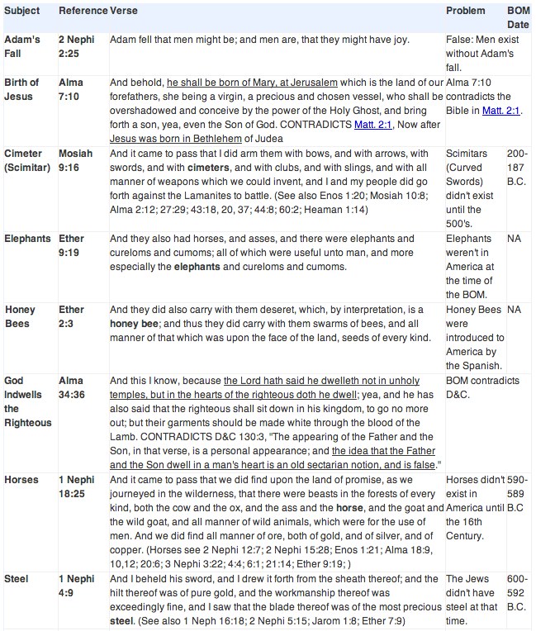
Notes:
http://carm.org/problems-with-the-book-mormon

Slide 101
Issues with the B.O.M.
( DouglasJacoby.com)
5. RACISM
2 Nephi 5 – curse of dark skin (though chapter 26 seems to allow that blacks are God’s children, too).
Alma 3 – curse of dark skin on Lamanites.
3 Nephi 2 – Lamanites blessed, — lose dark skin, become white.
In the book of Jacob, the dark-skinned will eventually be blessed.
Native Americans are descended from Jews – but they were unreceptive to the Mormon message, and showed no familiarity with Judaism (nor genetic relationship).
Blacks are spirits who in preexistence rebelled against God – their punishment was to inhabit black bodies.
Some Mormon missionaries promised darker races they will be white in the next life if they convert.
1976—Mormon bishop in Vancouver excommunicated for accepting a black into the Mormon priesthood.
1978 “revelation” to president Spencer Kimball
Notes:
3000+ changes made between original BOM and today’s version.
Mormons today claim the Holy Spirit has given only the essence of the translation, not a word-for-word translation.

Slide 102
Other interesting beliefs
God was once a man like us.
God has a tangible body of flesh and bone.
God lives on a planet near the star Kolob.
God ("Heavenly Father") has at least one wife, our "Mother in Heaven," but she is so holy that we are not to discuss her nor pray to her.
Jesus was married.
We can become like God and rule over our own universe.
There are many gods, ruling over their own worlds.
Jesus and Satan ("Lucifer") are brothers, and they are our brothers - we are all spirit children of Heavenly Father
Jesus Christ was conceived by God the Father by having sex with Mary, who was temporarily his wife.
We should not pray to Jesus, nor try to feel a personal relationship with him.
The "Lord" ("Jehovah") in the Old Testament is the being named Jesus in the New Testament, but different from "God the Father" ("Elohim").
In the highest degree of the celestial kingdom some men will have more than one wife.
Before coming to this earth we lived as spirits in a "pre-existence", during which we were tested; our position in this life (whether born to Mormons or savages, or in America or Africa) is our reward or punishment for our obedience in that life.
Dark skin is a curse from God, the result of our sin, or the sin of our ancestors. If sufficiently righteous, a dark-skinned person will become light-skinned.
The Garden of Eden was in Missouri. All humanity before the Great Flood lived in the western hemisphere. The Ark transported Noah and the other survivors to the eastern hemisphere.
Not only will human beings be resurrected to eternal life, but also all animals - everything that has ever lived on earth - will be resurrected and dwell in heaven.
Christ will not return to earth in any year that has seen a rainbow.
Mormons should avoid traveling on water, since Satan rules the waters.
The sun receives its light from the star Kolob.
If a Gentile becomes Mormon, the Holy Ghost actually purges his Gentile blood and replaces it with Israelite blood.
A righteous Mormon will actually see the face of God in the Mormon temple.
You can identify a false angel by the color of his hair, or by offering to shake his hand.

Slide 103
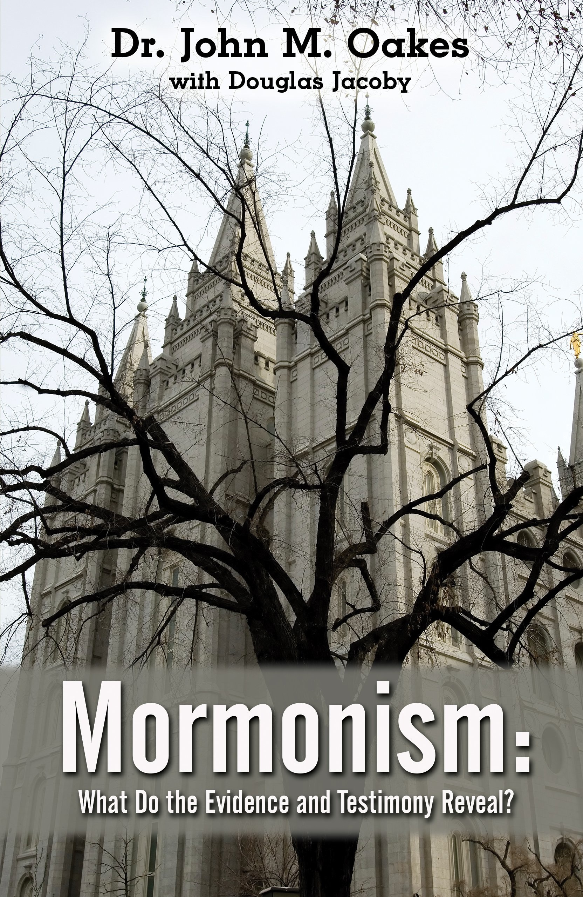
For a more in-depth study:

Slide 104
Helpful scriptures
Galatians 1:6-9
2 Timothy 3:1-9
2 Thessalonians 2:5-12
1 John 2:18-23

